Slide 1


Digital Electronics Fundamentals 202.1
-Binary Numeral System
-Hexadecimal Numeral System
-BCD code
-Inverters
-7 Segment Displays
-BCD to 7 Segment Drivers
-Lab: Typical 7 Segment Circuit

Slide 2
1 Binary Numeral System
The binary numeral system, or base-2 number system, represents numeric values using two symbols: 0 and 1. More specifically, the usual base-2 system is a positional notation with a radix of 2. Because of its straightforward implementation in digital electronic circuitry using logic gates, the binary system is used internally by almost all modern computers and computer-based devices such as mobile phones.
Any number can be represented by any sequence of bits (binary digits)
Since binary is a base-2 system, each digit represents an increasing power of 2, with the rightmost digit representing 2⁰, the next representing 2¹, then 2², and so on. To determine the decimal representation of a binary number simply take the sum of the products of the binary digits and the powers of 2 which they represent. For example, the binary number: 100101
is converted to decimal form by:
[(1) × 2⁵] + [(0) × 2⁴] + [(0) × 2³] + [(1) × 2²] + [(0) × 2¹] + [(1) × 2⁰] =
[1 × 32] + [0 × 16] + [0 × 8] + [1 × 4] + [0 × 2] + [1 × 1] = 37
**Excerpt taken from: Wikipedia Article on Binary Numeral System

Slide 3
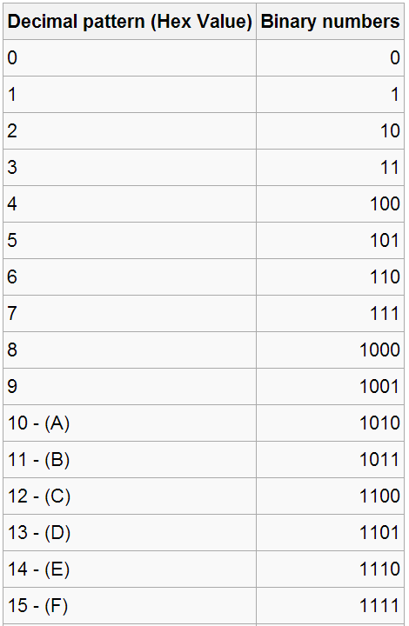
1.1 Binary Numbering System
**Table taken from: Wikipedia Article on Binary Numeral System

Slide 4
2 Hexadecimal Numeral System
In mathematics and computer science, hexadecimal (also base 16, or hex) is a positional numeral system with a radix, or base, of 16. It uses sixteen distinct symbols, most often the symbols 0–9 to represent values zero to nine, and A, B, C, D, E, F (or alternatively a–f) to represent values ten to fifteen. For example, the hexadecimal number 2AF3 is equal, in decimal, to (2 × 16³) + (10 × 16²) + (15 × 16¹) + (3 × 16⁰), or 10995
Each hexadecimal digit represents four binary digits (bits), and the primary use of hexadecimal notation is a human-friendly representation of binary-coded values in computing and digital electronics. One hexadecimal digit represents a nibble, which is half of an octet (8 bits).Each hexadecimal digit represents four binary digits (bits), and the primary use of hexadecimal notation is a human-friendly representation of binary-coded values in computing and digital electronics. One hexadecimal digit represents a nibble, which is half of an octet (8 bits).
Byte values can range from 0 to 255 (decimal), but may be more conveniently represented as two hexadecimal digits in the range 00 to FF. Hexadecimal is also commonly used to represent computer memory addresses.
**Excerpt taken from: Wikipedia Article on Hexadecimal Numeral System

Slide 5
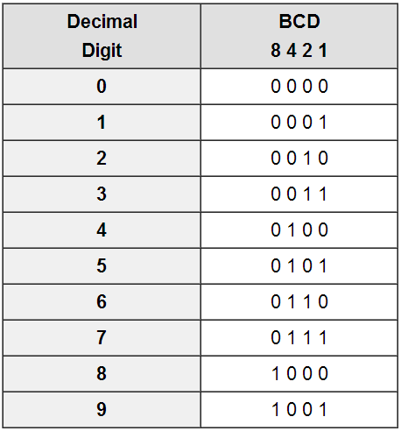
3 Binary Coded Decimals (BCD)
In computing and electronic systems, binary-coded decimal (BCD) is a class of binary encodings of decimal numbers where each decimal digit is represented by a fixed number of bits, usually four.
BCD's main virtue is a more accurate representation and rounding of decimal quantities as well as an ease of conversion into human-readable representations.
**Excerpt taken from: Wikipedia Article on Binary Coded Decimals

Slide 6
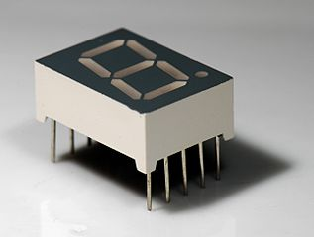
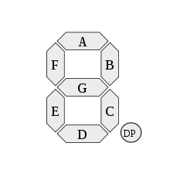
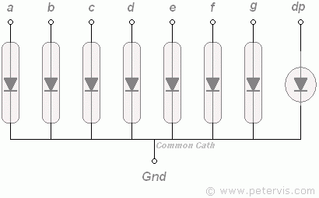
4 7 Segment Displays
A seven-segment display is a form of electronic display device for displaying decimal numerals that is an alternative to the more complex dot-matrix displays. Seven-segment displays are widely used in digital clocks, electronic meters, and other electronic devices for displaying numerical information.
In a simple LED package, typically all of the cathodes (negative terminals) or all of the anodes (positive terminals) of the segment LEDs are connected and brought out to a common pin; this is referred to as a "common cathode" or "common anode" device. Hence a 7 segment plus decimal point package will only require nine pins
**Excerpt taken from: Wikipedia Article on 7 Segment Displays

Slide 7
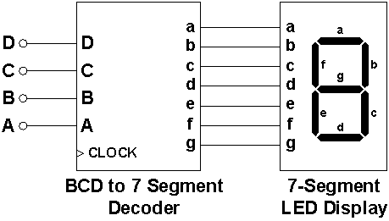
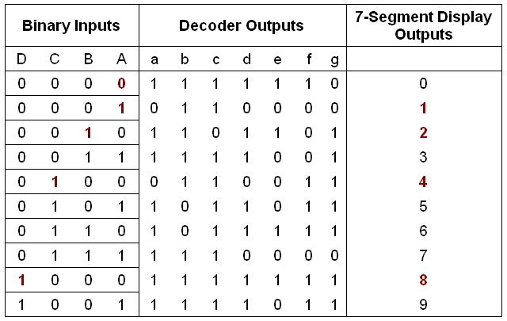
5 BCD to 7 segment Display Decoder
A BCD to 7-segment decoder driver’s function is to convert the logic states at the outputs of a BCD, or binary coded decimal into signals which will drive a 7-segment display. The display shows the decimal numbers 0-9 and is easily understood.
Most Popular BCD to 7 Seg Decoders are the 74xx47 and 45xx11 Ics.

Slide 8
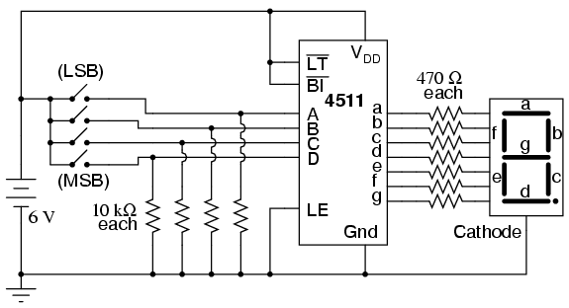
6 Typical use for a 7 Seg Display

Slide 9
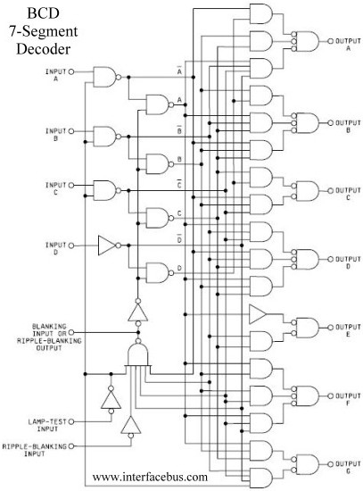
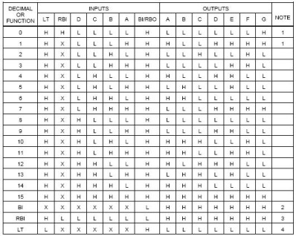
7 Inside a BCD to 7 Seg Decoder

Slide 10
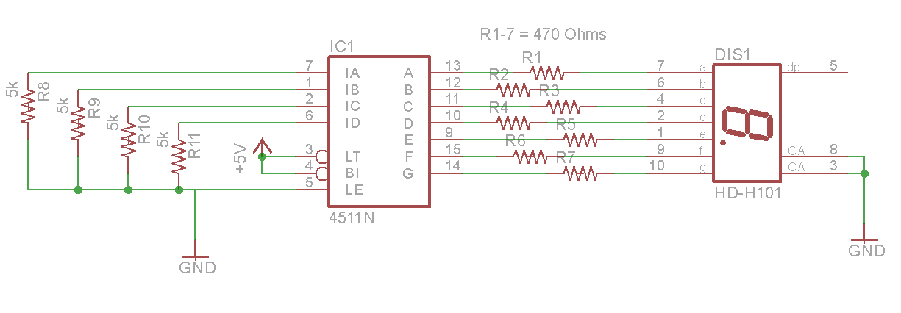
8 Lab: Typical 7 Segment Circuit

